Slide 1
Hw2 Stencil buffer, Depth buffer, Blending

Slide 2
Overview
Parameters of scene
Mirror
Control
RESULT(you can see video on E3)
Recommend Algorithm
Some error you may encounter
Depth buffer error
Stencil buffer error
Blending error
Coordinate axis of mirror scene error
Upload homework
Score

Slide 3








Parameters of scene
3$\sqrt{2}$
3$\sqrt{2}$
3$\sqrt{2}$
3$\sqrt{2}$
5
$${45}^{o}$$
$${45}^{o}$$
5
$${45}^{o}$$
$${45}^{o}$$
2
PPAP(CENTER)
3
3
(0,0,0)
Length of every mirror
Diagram of Hw2

Slide 4


Parameters of scene
(-1.5,0, -3.5)
(1.5,0, -3.5)
5
$${45}^{o}$$
$${45}^{o}$$
5
2
(3.0,0)
(-3.0,0)
3
3
Center(0,0,0)
Position of every mirror

Slide 5
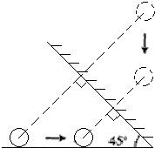
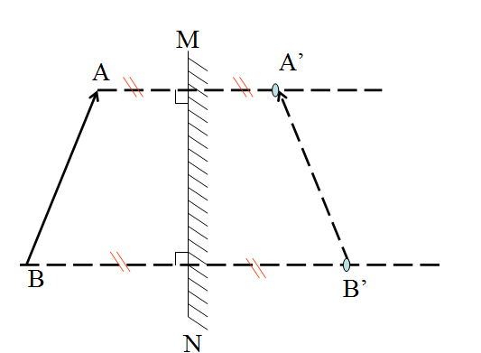
Mirror

Slide 6
Control(lower case)
q:camera turn left
e:camera turn right
w:camera move in
a:camera move left
s:camera move out
d:camera move right

Slide 7
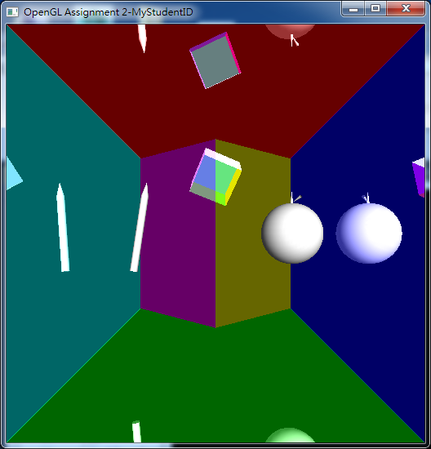
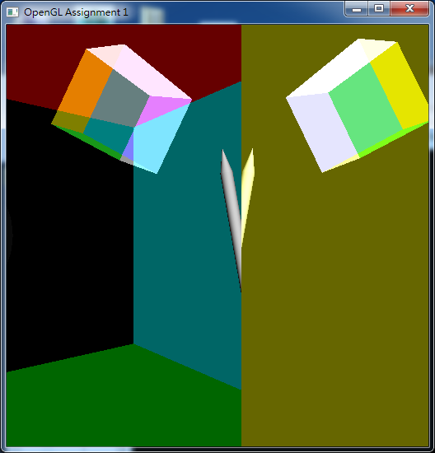
RESULT

Slide 8
Recommend Algorithm
Draw Scenes of Mirror
In this homework, all scenes of mirror are independent.
In scenes of mirror, you only need to draw PPAP but other mirrors.
Draw PPAP

Slide 9
Some error you may encounter
Depth buffer error
Stencil buffer error
Blending error
Coordinate axis of mirror scene error

Slide 10
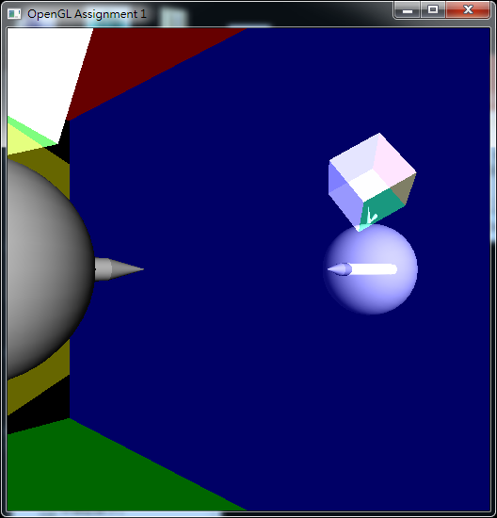
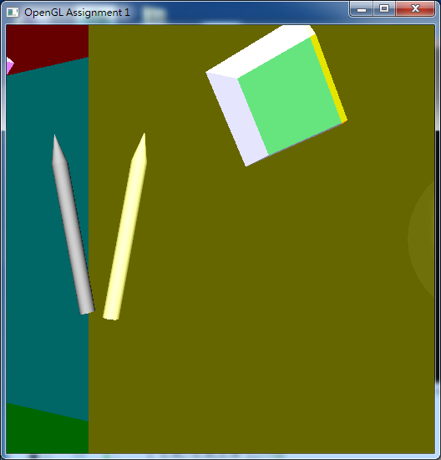
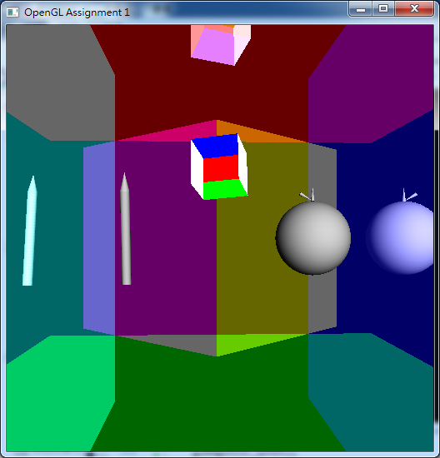
Depth buffer error

Slide 11
Depth buffer error1
What happened?
Disable(Depth test)
How to solve it?
Draw mirror without color to write Z-buffer(Depth buffer)
“glColorMask” can approach this
After writing z-buffer, draw mirror when pass z-buffer(adjust “glDepthFunc”)

Slide 12
Depth buffer error2(Actually, this is blending error)
What happened?
Depth test is not enabled in mirror scene
Blending failed
Blending failed?
In draw PPAP, first draw pen then apple.
When draw pen, Z value is far plane. It works.
When draw apple, Z of apple is less than pen. It draws
When draw apple, you enable blending. So, blending apple with pen will happen.
How to solve it?
When draw PPAP, Disable blending.

Slide 13
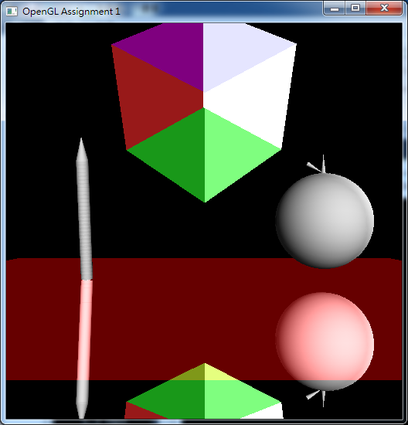
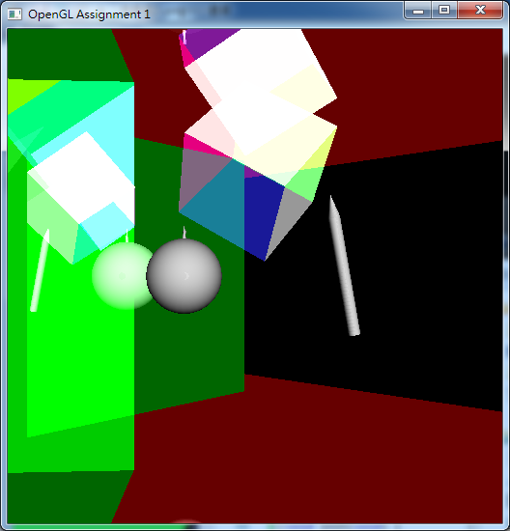
Stencil buffer error

Slide 14
Stencil buffer error1
What happened?
When draw mirror, you disable depth test or they pass depth test. This cause stencil buffer error.
Or, stencil buffer not cleaned after draw other mirror scene.
How to solve it?
See depth buffer error1 if you encounter first situation.
Clean stencil buffer each time you draw mirror scene.

Slide 15
Stencil buffer error2
What happened?
Stencil test disabled or all stencil test passed.
How to solve it?
Check glStencilFunc, glStencilOp.
When draw mirror scene(below), they should be drawn if they pass stencil test.

Slide 16
Blending error
See depth buffer error

Slide 17
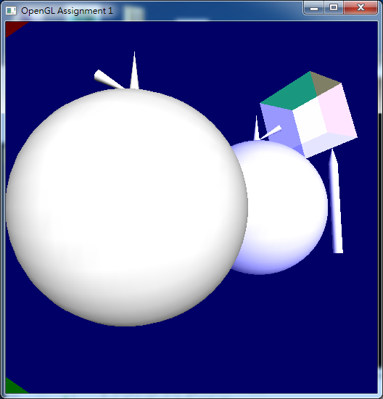
Coordinate axis of mirror scene error

Slide 18
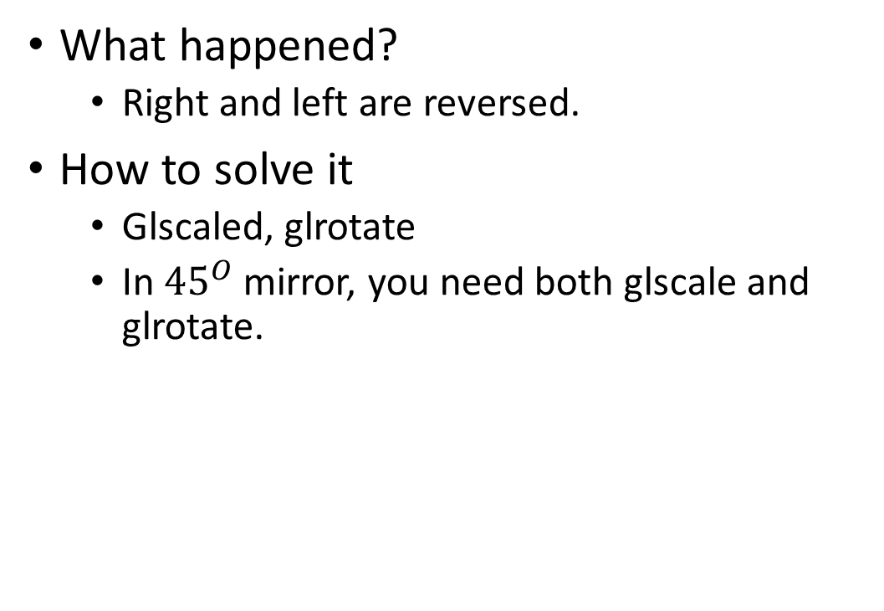
Coordinate axis of mirror scene error1
What happened?
Right and left are reversed.
How to solve it
Glscaled, glrotate
In ${45}^{O}$ mirror, you need both glscale and glrotate.

Slide 19
Coordinate axis of mirror scene error2
What happened?
Depth buffer error and mirror scene position error.
How to solve it?
See above if depth error
AM=A’M
Be aware of
Vertical symbol

Slide 20
Upload homework
Upload .zip or .7z for your project with your ID.
Example: 0123456_hw2.zip
Linux
Code, makefile, read me(if you do other bonus)
Windows
package all project without “Hw2.VC.db” at root directory
read me(if you do other bonus)

Slide 21
Score
Depth buffer(40%)
Stencil buffer(30%)
Blending(20%)
Physics(10%)
Upload neither zip nor 7z file(-10%)
Upload linux code without makefile(-10%)
Didn’t type in studentID(-10%)
glutCreateWindow("OpenGL Assignment 2-MyStudentID");

